Slide 1

Weather Patterns
Data Analytics and Visualization Final Project
John Bates | Brittany Woolard | Danielle Duce | Lakenia Manago
Notes:
Lakenia

Slide 2
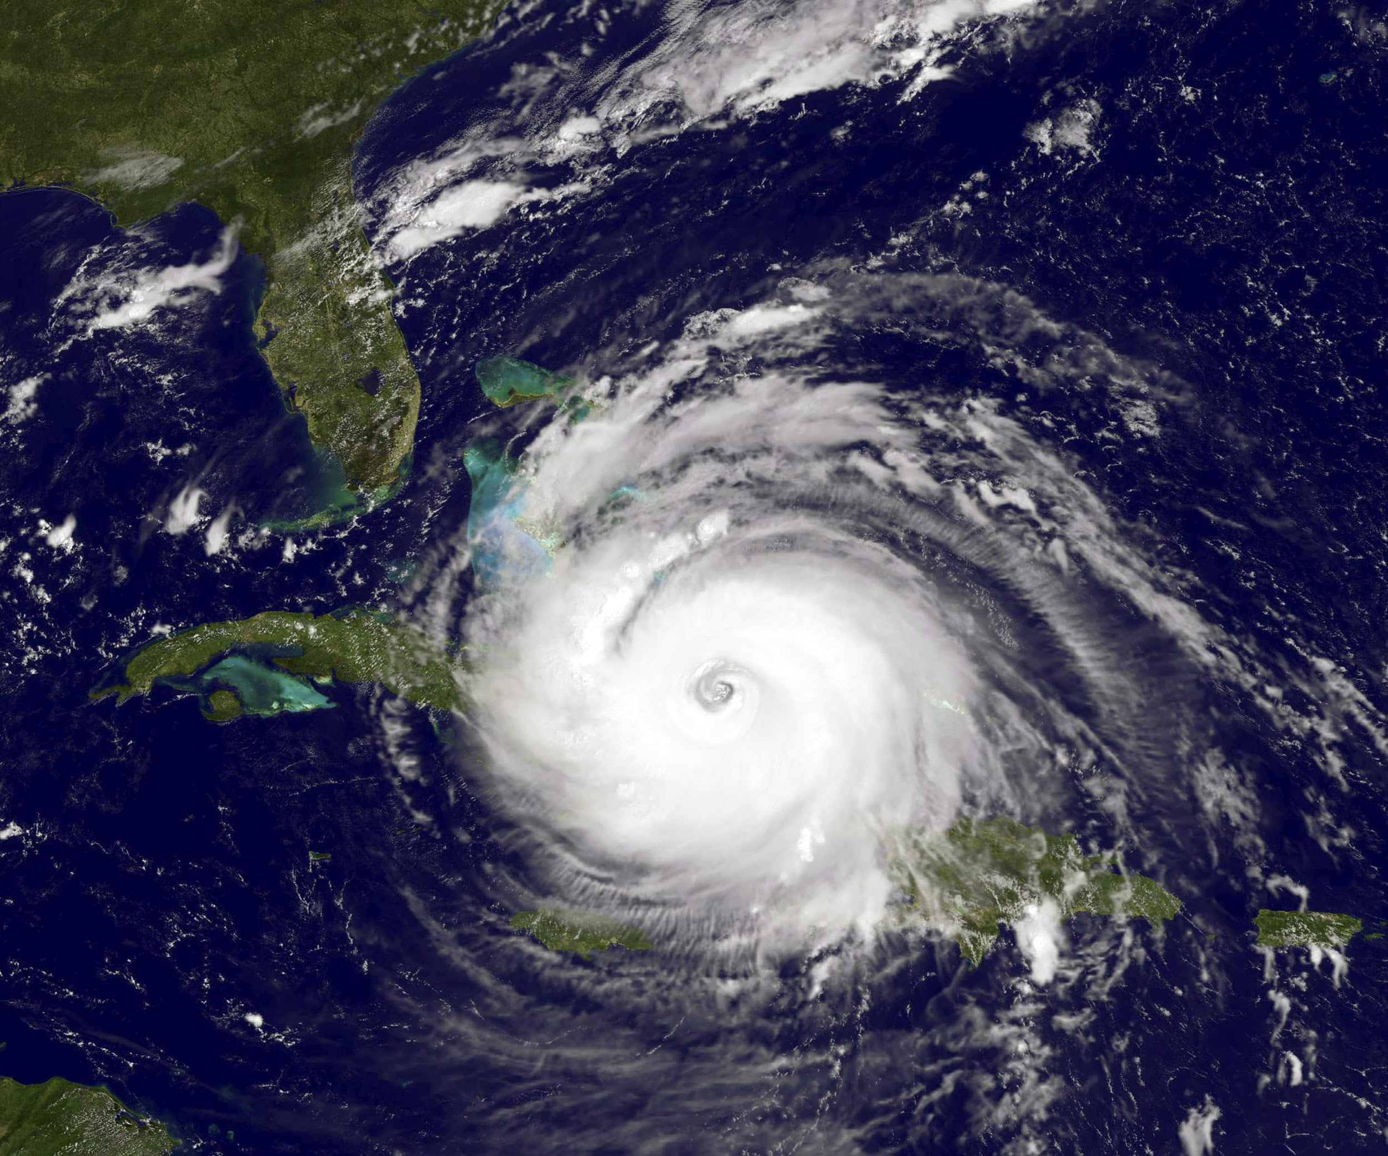
Agenda
Purpose & Data Exploration
Data Preprocessing & Structure
Database Structure & Creation
Data Analysis & Machine Learning
Visualizations and Dashboard
Tools & Recommendations
Notes:
Lakenia

Slide 3

Purpose
Analyze weather patterns among the east coast
Predict the likelihood of bad weather
Determine factors contributing to storm strikes in Florida
Provide analysis for meteorologists
Notes:
Lakenia

Slide 4
Data Exploration Phase
Questions we want to answer
What factors contribute to storm strikes in Florida?
What weather patterns did we observe with our data?
Finding the best data that fits our needs
How do we filter our data to suit our analysis?
What database structure can we use to present our findings?
What are the optimal tools to present our data?
Notes:
Lakenia

Slide 5
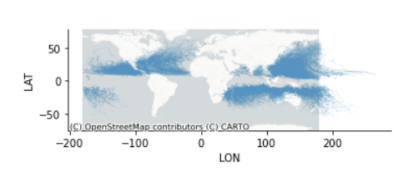
Data Preprocessing
Data Sources:
Storm Events DB from NOAA.gov (CSV file)
Geojson of US states from GitHub
Preprocessing steps:
Data files are imported to Pandas dataframes.
Unnamed storms are dropped from dataframe.
Data is mapped in Pandas to view data points.
Notes:
John
Storm DB all tropical storms since 1980, has a row for each storm every 3 hours, data includes year, basin, time, nature, lat, long, speed, direction.
Target geojson is Florida. NOAA - National Oceanic and Atmospheric Administration

Slide 6

Data Preprocessing
Preprocessing steps (cont.):
Geohash columns are created for latitude and longitude coordinates using pygeohash.
Geohash encodes a geographic location into a string of letters and digits.
The length of the geohash determines the area covered by the geohash.
In our analysis we are using the following geohash lengths.
Geohash Level | CellWidth | Cell Height
2 | 1,250 km | 625 km
5 | 4.89 km | 4.89 km
Notes:
John
Geohash levels go up to 12. Level 12 - 18.6mm, level 5,000 km

Slide 7
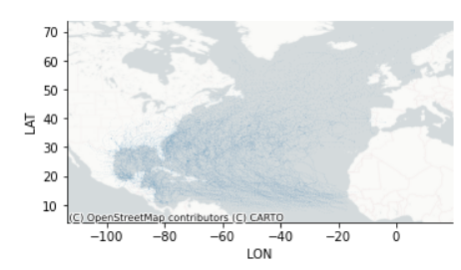
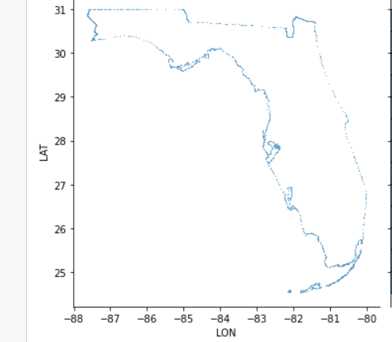
Data Preprocessing
Preprocessing steps (cont.):
Dataframe is filtered to the North Atlantic region.
Florida geojson file is imported to Pandas.
Florida geohash values are calculated.
Dataframes are exported to Postgres for DB processing.
Notes:
John

Slide 8
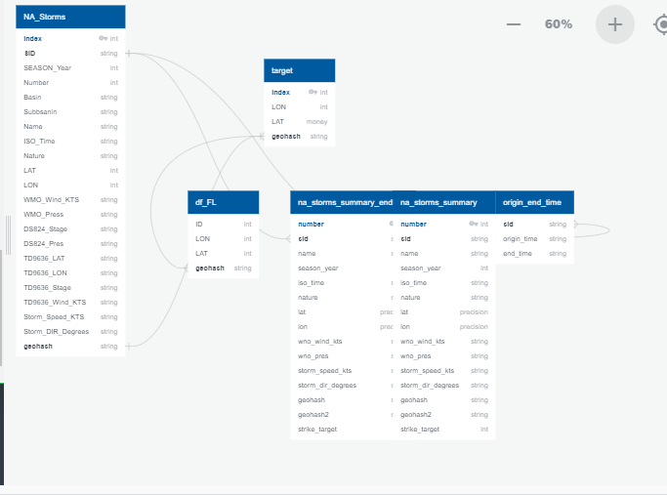
Database Structure
Entity Relationship Diagram
Notes:
John

Slide 9
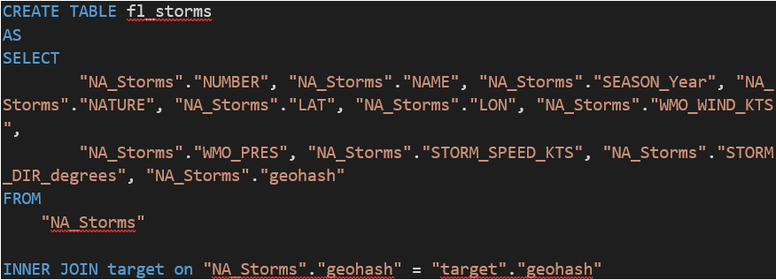
Database Structure
NA_Storms and Target tables are imported from Pandas
Fl_storms - created with the following query
Notes:
John
Inner join on geohash to determine storms that strike the target area.

Slide 10
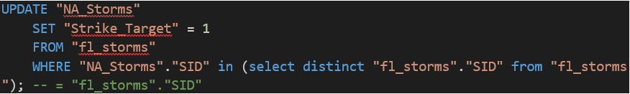
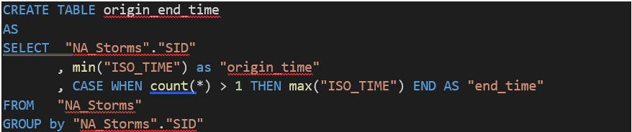
Database Structure
Strike Target
Origin_end_time
Notes:
John
Set value of “Strike_Target” to 1 if exists in “fl_storms” table. Note, a 1 in the
Strike_Target column indicates a storm strike in the target area
Origin_end_time takes the first and last posting for each storm ID by timestamp.

Slide 11
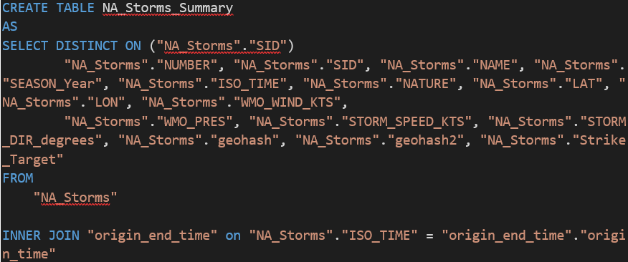
Database Structure
NA_storms_summary
NA_storms_summary_endtime
Notes:
John
Summary tables take the first entry for each storm from NA_storms table based on the origin time.
Summary tables are imported back to pandas and exported to csv files for machine learning and visualization.

Slide 12
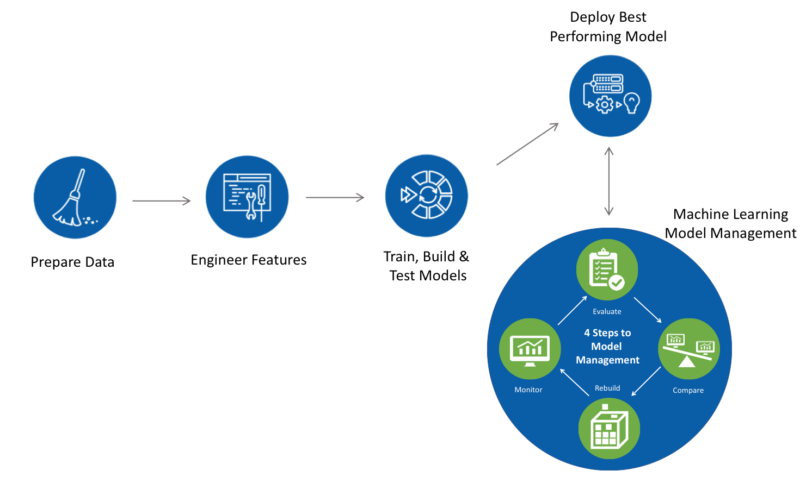
Machine Learning & Pipeline
Notes:
Brittany
Machine learning is a method of data analysis that automates analytical model building
So here we have the machine learning pipeline.
1st- we prepare the data by understanding the data process, and data cleansing .
2nd- Is the engineer features this is the process where you do selection process to identify important features of our models.
3rd- Train, build, and Test and this is where you perform the model
And last you will deploy your best performing model.

Slide 13
Data Analysis
Machine Learning Model
Steps in Logistic Regression : Below steps are required in development of our model
●Data Preprocessing
●Exploratory Data Analysis
●Feature Scaling
●Logistic Regression
●Predicting the Test Result
●Test Accuracy of Model
Notes:
Brittany
For our Data Analysis
The steps below are required in development of our model.
These steps include (read bullet points)
I will go a little more in detail in the next few slides.

Slide 14
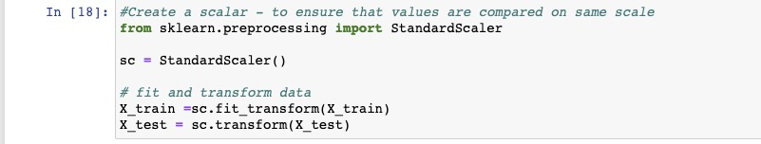
Data Analysis
Feature Scaling
Helps to normalize range of our features in our data.
Need to scale the data so our machine learning model can interpret these features on the same scale
Notes:
Brittany
Feature scaling helps normalize the range of our features in our data
feature scaling is important because we want accurate results of predictions. We need to scale the data so our machine learning model can interpret the features on the same scale.
So we will only scale the independent variable because our dependent variable has only 0 and 1 values.

Slide 15
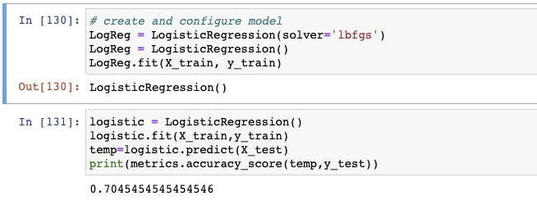
Data Analysis
Logistic Regression Model
Split Data
Model
Accuracy of logistic regression classifier is 70 percent
Notes:
Brittany
Continuing on we have to split and test the dataset. This step is necessary for performance.
We used train test split from sklearn to divide our data into training and testing groups
Then we ran the logistic regression classifier for 500 iterations. The regression analysis produced an accuracy score of 70%.

Slide 16
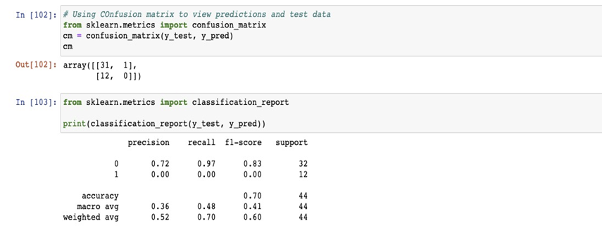
Data Analysis
Testing Accuracy of Model
Confusion matrix was used to test accuracy of our classification
Notes:
Brittany
We created confusion matrix to check accuracy of our classification of storm target. We used confusion_matrix function of the sklearn library. After importing the function, we called it a new variable cm. The function accepts two parameters, mainly the actual values and predicted values.

Slide 17
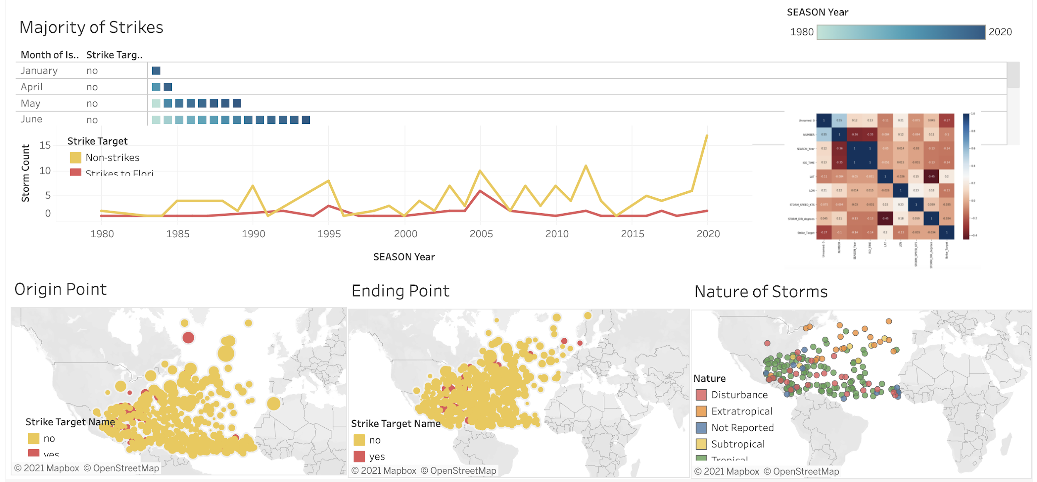
Data Analysis
Visualize the Data
Tableau Dashboard
Notes:
Storm Strike Dashboard Link
Danielle
Majority and FL strikes - First we wanted to see when are the majority of storms happening per year as well as during which month - Looking at the data, August and September have the majority of storms with strikes to Florida and in 2005 we saw our best year yet
I then filtered the data by Origin of storm and end of storm to see if there was a pattern or correlation. Looking at the different visuals “end of storm” has a lot more storm ending coordinates than the origin graph. While I am unsure of why this is, you can see in red which storms actually hit florida from where they began to where they ended.
Our last visual represents the type or storm or nature of the storm. If we hover over the different ones, we can see based on the storm type what hit Florida. The storm natures differ depending on where the storm came from. So extratropical also known as nor’easters and blizzards come from the north. While sub tropical tend to grow in to tropical storms which can end up as Hurricanes.

Slide 18
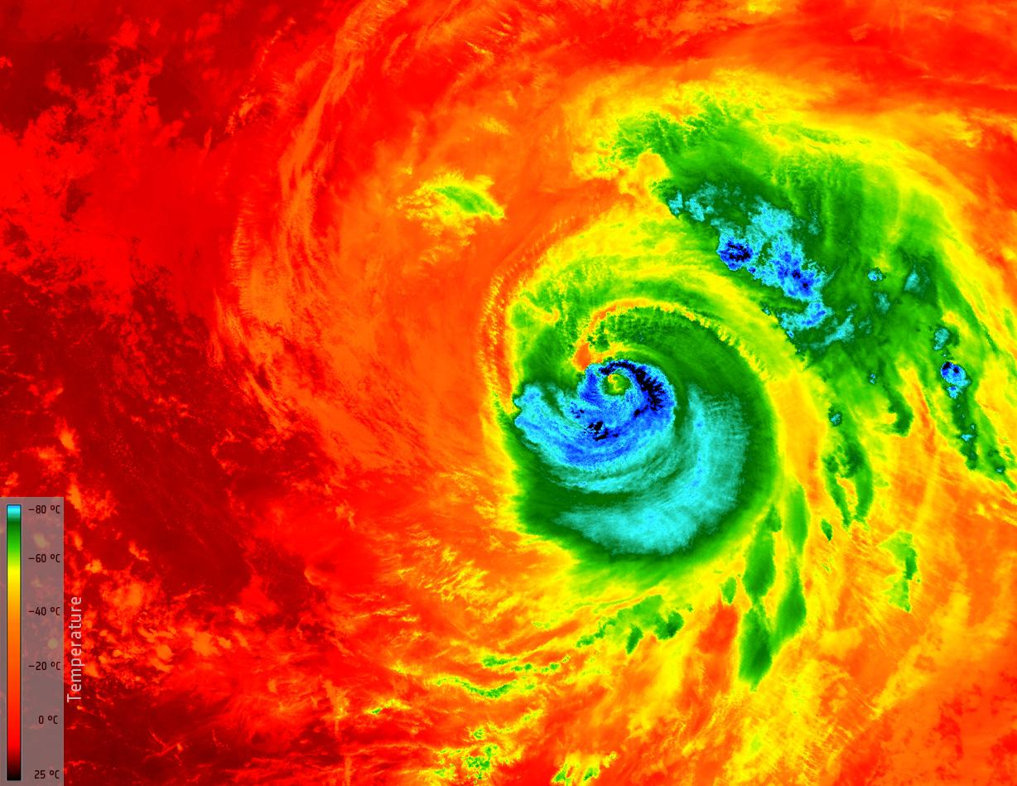
Tools Used
Preprocessing
Pandas, Numpy, CSV
Matplotlib, Geopandas
Seaborn, Contextily
Pygeohash, Polygeohasher
Creating Database
PostgresSQL
Connecting to Database
SQLAlchemy, Psycopg2 module
Machine Learning
Sklearn.preprocessing
sklearn.metric
Dashboard
Tableau
Notes:
Danielle
Just read slide

Slide 19
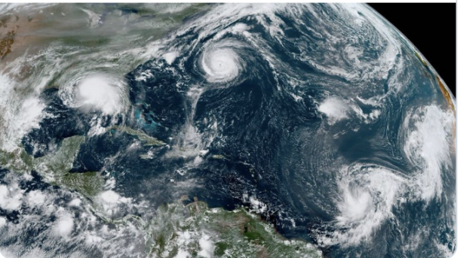
Recommendations for Future Analysis
Explore other features for correlation
Make other analysis based on the severity of the storm
Explore a different machine learning model to achieve different results
Notes:
Danielle
Our recommendations for future analysis would be to explore other features that possibly would correlate to our ending goal. We could have also took in to consideration different analysis based on severity of the storms, so really taking a look at storm natures and categories more closely. Lastly, we can look at using a different machine learning model than the one that we used to see if our results differ.

